Slide 1
7 Series FPGA Overview
Part 1

Slide 2
Objectives
After completing this module, you will be able to:
Identify and differentiate the members of the 7 series families

Slide 3



7 Series FPGA Families
Lowest Power
and Cost
Industry’s Best Price/Performance
Industry’s Highest System Performance
Maximum Capability
Logic Cells | 20K – 355K | 70K – 480K | 285K – 2,000K
Block RAM | 12 Mb | 34 Mb | 65 Mb
DSP Slices | 40 – 700 | 240 – 1,920 | 700 – 3,960
Peak DSP Perf. | 504 GMACS | 2,450 GMACs | 5,053 GMACS
Transceivers | 4 | 32 | 88
Transceiver Performance | 3.75Gbps | 6.6Gbps and 12.5Gbps | 12.5Gbps, 13.1Gbps and 28Gbps
Memory Performance | 1066Mbps | 1866Mbps | 1866Mbps
I/O Pins | 450 | 500 | 1,200
I/O Voltages | 3.3V and below | 3.3V and below 1.8V and below | 3.3V and below 1.8V and below
Notes:
The Xilinx 7 series FPGAs are a unified set of FPGA families. These families share the same underlying technology, construction, and implementation tools.
The families are optimized for different price/performance points to meet all market needs. However, the unified architecture allows migration capability from one family to another.

Slide 4
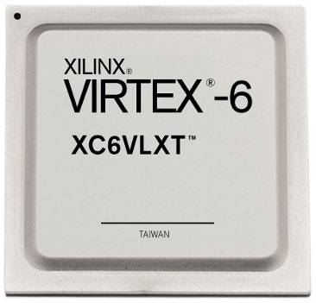
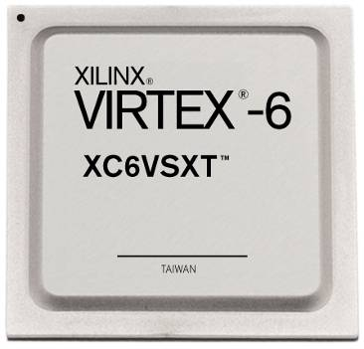
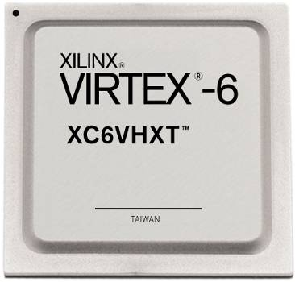
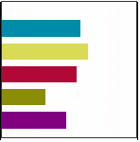
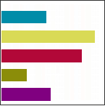
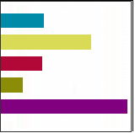
Virtex-7 Devices
The Virtex-7 family has several devices
Virtex-7: General logic
Virtex-7XT: Rich DSP and block RAM, higher serial bandwidth
Virtex-7HT: Highest serial bandwidth
Virtex-7
Virtex-7XT
Virtex-7HT
Logic
Block RAM
DSP
Parallel I/O
Serial I/O
High Logic Density
High-Speed Serial Connectivity
High Logic Density
High-Speed Serial Connectivity
Enhanced DSP
High Logic Density
Ultra High-Speed Serial Connectivity

Slide 5
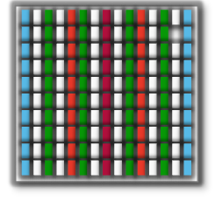
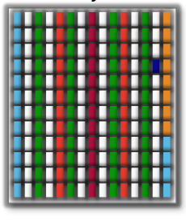
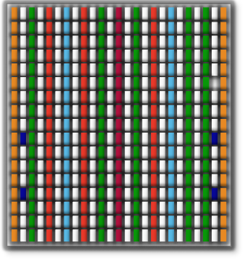
Architecture Alignment
Common elements enable easy IP reuse for quick design portability across all 7 series families
Design scalability from low-cost to high-performance
Expanded eco-system support
Quickest TTM
Artix™-7 FPGA
Logic Fabric
LUT-6 CLB
Precise, Low Jitter Clocking
MMCMs
Kintex™-7 FPGA
On-Chip Memory
36Kbit/18Kbit Block RAM
Enhanced Connectivity
PCIe® Interface Blocks
DSP Engines
DSP48E1 Slices
Hi-perf. Parallel I/O Connectivity
SelectIO™ Technology
Hi-performance Serial I//O Connectivity
Transceiver Technology
Virtex®-7 FPGA
Notes:
All 7 series families share the same basic building blocks. The mixture and number of these resources varies across families.

Slide 6
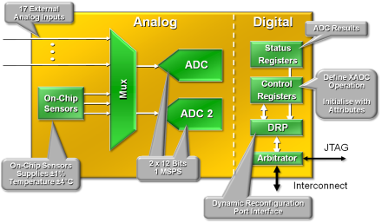
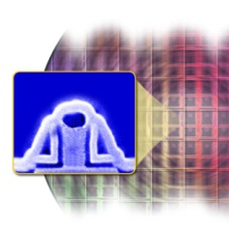
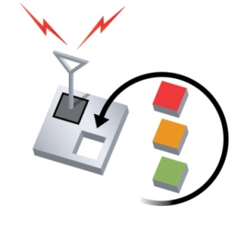

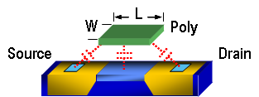
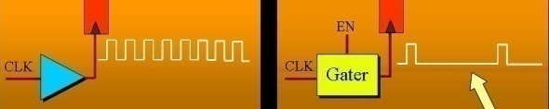
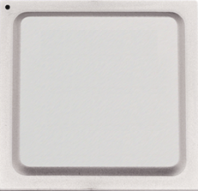
Strong Focus on Power Reduction
Reducing
Static Power
Additional
Power Saving
Features
High performance,
low power process
Integrated Analog Front End
Transistor choice
optimization
V_{CCAUX}
Design Green
Reduced from
2.5V to 1.8V
5th gen. partial
reconfiguration
With Xilinx
Config
Memory
BRAM
Unused BRAM
Power Savings
Before
After
Process Shrink
Reducing
Dynamic Power
Fine grain clock and logic gating
IO Design &
User Power
Saving Modes
Optimized Hard Blocks
V_{CCO}
Lower device
core voltage
-1 L
Xilinx
7 Series
FPGAs
+
Pad
In
-
Reducing
I/O Power
Out
Notes:
The key to both high performance and low cost applications is reducing power.
The Xilinx 7 series FPGAs include many innovations to reduce power in all FPGAs:
28nm High-K Metal Gate (HKMG) process technology
High Performance Low Power (HPL) library
Fine grain clock gating
Core voltage scaling
Block RAM power-down
Reduced VCCAUX and I/O pre-driver voltages
I/O power saving modes

Slide 7
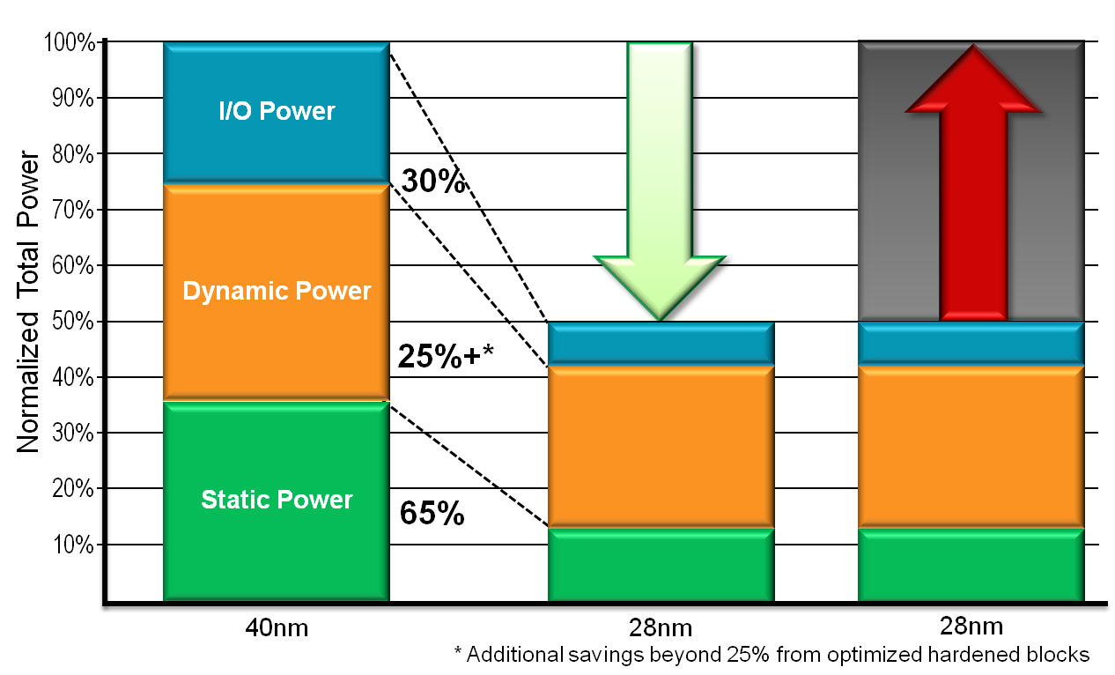
7 Series Lower Power Differentiation
50% lower total power
65% lower static power enabled by 28nm High-Performance, Low-Power (HPL) HKMG process
25%+ lower dynamic power via architectural evolution
30% lower I/O power with enhanced capability
System design flexibility
50% lower power budget
OR
Take advantage of additional usable performance and capacity at the previous power budget
Increase Usable
Performance and Capacity
50% Lower Power
OR
Notes:
The power reductions shown here are relative to a 40-nm device.

Slide 8
Summary
Rich set of families to address all areas of the FPGA market
Artix-7 family: Lowest price and power
Kintex-7 family: Best price/performance
Virtex-7 family: Highest performance/capacity
Unified architecture reduces learning curve for new designs
Builds on the strengths of the Virtex-6 and Spartan-6 families
Strong focus on power reduction
New architectural features for the highest performance and lowest power

Slide 9
Where Can I Learn More?
Xilinx Education Services courses www.xilinx.com/training
Designing with 7-Series Device Families course
How to get the most out of both device families
How to build the best HDL code for your FPGA design
How to optimize your design for Spartan-6 and/or Virtex-6
How to take advantage of the newest device features
Free Video Based Training
Part 1,2, and 3 of the 7 Series FPGA Overview
How Do I Plan to Power My FPGA?
What are the Spartan-6 Power Management Features?
What are the Virtex-6 Power Management Features?
Basic FPGA Configuration, Parts 1 and 2

Slide 10
Trademark Information
Xilinx is disclosing this Document and Intellectual Property (hereinafter “the Design”) to you for use in the development of designs to operate on, or interface with Xilinx FPGAs. Except as stated herein, none of the Design may be copied, reproduced, distributed, republished, downloaded, displayed, posted, or transmitted in any form or by any means including, but not limited to, electronic, mechanical, photocopying, recording, or otherwise, without the prior written consent of Xilinx. Any unauthorized use of the Design may violate copyright laws, trademark laws, the laws of privacy and publicity, and communications regulations and statutes.
Xilinx does not assume any liability arising out of the application or use of the Design; nor does Xilinx convey any license under its patents, copyrights, or any rights of others. You are responsible for obtaining any rights you may require for your use or implementation of the Design. Xilinx reserves the right to make changes, at any time, to the Design as deemed desirable in the sole discretion of Xilinx. Xilinx assumes no obligation to correct any errors contained herein or to advise you of any correction if such be made. Xilinx will not assume any liability for the accuracy or correctness of any engineering or technical support or assistance provided to you in connection with the Design.
THE DESIGN IS PROVIDED “AS IS" WITH ALL FAULTS, AND THE ENTIRE RISK AS TO ITS FUNCTION AND IMPLEMENTATION IS WITH YOU. YOU ACKNOWLEDGE AND AGREE THAT YOU HAVE NOT RELIED ON ANY ORAL OR WRITTEN INFORMATION OR ADVICE, WHETHER GIVEN BY XILINX, OR ITS AGENTS OR EMPLOYEES. XILINX MAKES NO OTHER WARRANTIES, WHETHER EXPRESS, IMPLIED, OR STATUTORY, REGARDING THE DESIGN, INCLUDING ANY WARRANTIES OF MERCHANTABILITY, FITNESS FOR A PARTICULAR PURPOSE, TITLE, AND NONINFRINGEMENT OF THIRD-PARTY RIGHTS.
IN NO EVENT WILL XILINX BE LIABLE FOR ANY CONSEQUENTIAL, INDIRECT, EXEMPLARY, SPECIAL, OR INCIDENTAL DAMAGES, INCLUDING ANY LOST DATA AND LOST PROFITS, ARISING FROM OR RELATING TO YOUR USE OF THE DESIGN, EVEN IF YOU HAVE BEEN ADVISED OF THE POSSIBILITY OF SUCH DAMAGES. THE TOTAL CUMULATIVE LIABILITY OF XILINX IN CONNECTION WITH YOUR USE OF THE DESIGN, WHETHER IN CONTRACT OR TORT OR OTHERWISE, WILL IN NO EVENT EXCEED THE AMOUNT OF FEES PAID BY YOU TO XILINX HEREUNDER FOR USE OF THE DESIGN. YOU ACKNOWLEDGE THAT THE FEES, IF ANY, REFLECT THE ALLOCATION OF RISK SET FORTH IN THIS AGREEMENT AND THAT XILINX WOULD NOT MAKE AVAILABLE THE DESIGN TO YOU WITHOUT THESE LIMITATIONS OF LIABILITY.
The Design is not designed or intended for use in the development of on-line control equipment in hazardous environments requiring fail-safe controls, such as in the operation of nuclear facilities, aircraft navigation or communications systems, air traffic control, life support, or weapons systems (“High-Risk Applications”). Xilinx specifically disclaims any express or implied warranties of fitness for such High-Risk Applications. You represent that use of the Design in such High-Risk Applications is fully at your risk.
© 2012 Xilinx, Inc. All rights reserved. XILINX, the Xilinx logo, and other designated brands included herein are trademarks of Xilinx, Inc. All other trademarks are the property of their respective owners.

Slide 11
7 Series FPGA Overview
Part 2

Slide 12
Objectives
After completing this module, you will be able to:
Describe the architecture of the 7 series FPGAs

Slide 13
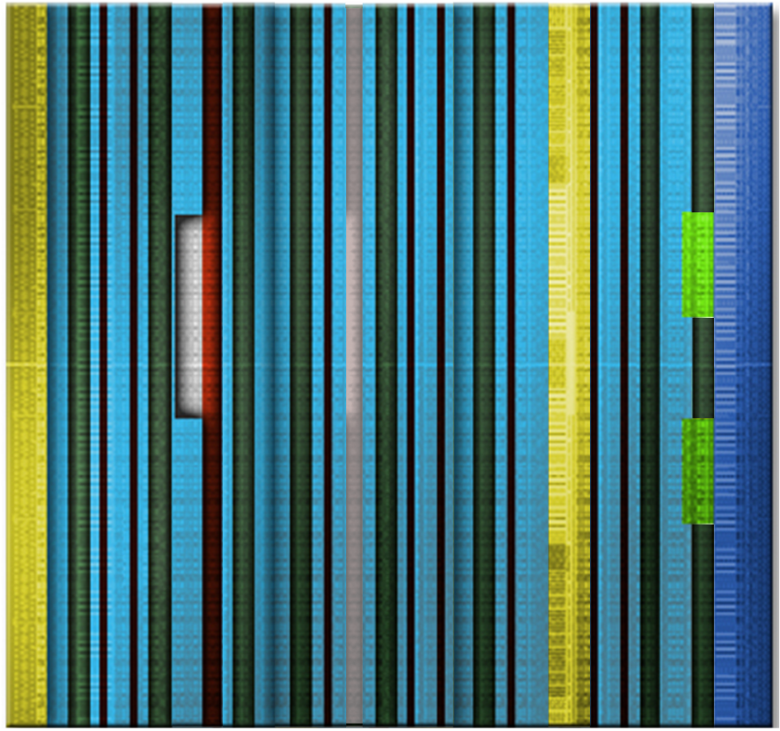
Fourth-Generation ASMBL Architecture
Optimized FPGA feature mix for different families/members
FPGA comprises columns of different resources
Clocking, I/O, BRAM, DSP, HSSIO
Enables the unified architecture between the different 7 series families
Enables different resource ratios within the different devices
SelectIO
& CMT
SelectIO
& CMT
Serial Transceiver
DSP
Logic
BRAM
Clock Buffers and Routing
PCI Express

Slide 14
7 Series FPGA Layout
All devices contain two I/O columns
Contains parallel I/O resources
Clock Management Tile (CMT) columns are adjacent to I/O columns
Enables high speed I/O interfaces
Clock routing resources are in the center column
High-speed serial I/O replace I/O banks in smaller devices or are contained in additional columns in larger devices
I/O
Clock Routing
HSSIO
CMT
CLB, BRAM, DSP
Notes:
The placement of the CMT columns adjacent to the I/O columns enables the highest speed I/O interfaces, including memory interfaces.
Because the clock routing resources remain in the center of the device, dedicated routing is required between the CMT and clocking columns.

Slide 15
Clock Regions and I/O Banks
Each clock region is 50 CLBs tall
An increase from 40 CLBs in previous technologies
Regional clock resources remain in the center of the clock region
25 rows of CLBs above and below the clock routing
I/O banks are 50 IOBs tall
An increase from 40 IOBs in previous technologies
I/O banks and clock regions are aligned, like in previous technologies
50 CLB
50 IOB

Slide 16
CLB Structure
SLICE
Two side-by-side slices per CLB
Slice_M are memory-capable
Slice_L are logic and carry only
Four 6-input LUTs per slice
Consistent with previous architectures
Single LUT in Slice_M can be a 32-bit shift register or 64 x 1 RAM
Two flip-flops per LUT
Excellent for heavily pipelined designs
LUT
SLICE
LUT
CLB

Slide 17
Block RAM
36K/18K block RAM
All Xilinx 7 series FPGA families use same block RAM as Virtex-6 FPGAs
Configurations same as Virtex-6 FPGAs
32k x 1 to 512 x 72 in one 36K block
Simple dual-port and true dual-port configurations
Built-in FIFO logic
64-bit error correction coding per 36K block
Adjacent blocks combine to 64K x 1 without extra logic
ADDRA
Port A
36
36
DIA
DOA
4
WEA
CLKA
36 Kb Memory Array
36
ADDRB
36
4
DIB
DOB
WEB
CLKB
Port B

Slide 18
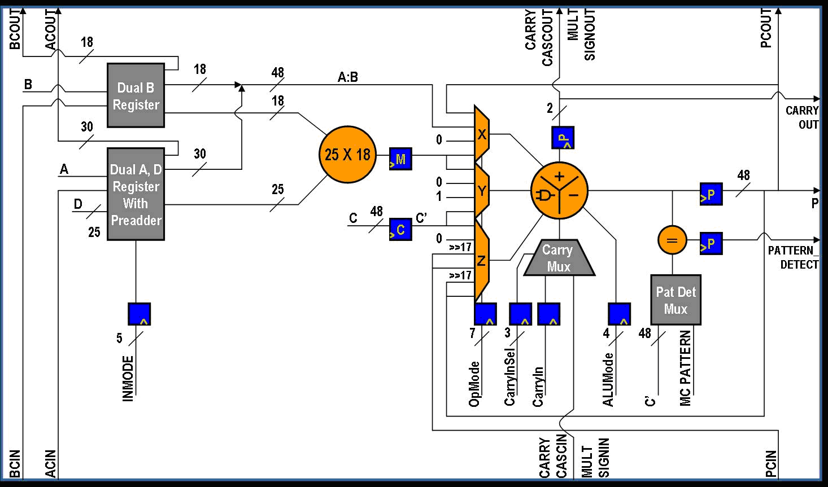
DSP Slice
All 7 series FPGAs share the same DSP slice
25x18 multiplier
25-bit pre-adder
Flexible pipeline
Cascade in and out
Carry in and out
96-bit MACC
SIMD support
48-bit ALU
Pattern detect
17-bit shifter
Dynamic operation (cycle by cycle)
Notes:
The DSP slice is the same one used in the Virtex-6 FPGA.

Slide 19
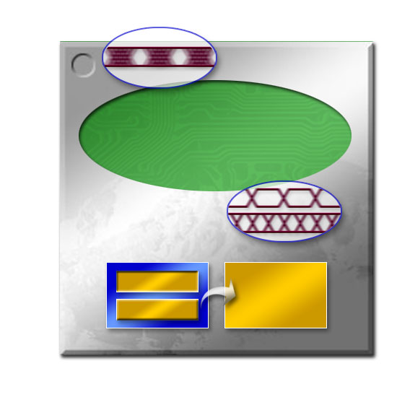

Clocking Resources
Based on the established Virtex-6 FPGA clocking structure
All 7 series FPGAs use the same unified architecture
Low-skew clock distribution
Combination of paths for driving clock signals to and from different locations
Clock buffers
High fanout buffers for connecting clock signals to the various routing resources
Clock regions
Device divided into clock regions with dedicated resources
Clock management tile (CMT)
One MMCM and one PLL per CMT
Up to 24 CMTs per device
MMCM
Clock Buffers
PLL
Clock Wizard
Automatic HDL code
Notes:
While based on the Virtex-6 FPGA, there are some significant improvements that will be described in the “Clocking Resources” module.

Slide 20

Input/Output Blocks
Two distinct I/O types
High range: Supports standards up to 3.3V
High performance: Higher performance with more I/O delay capability
Supports I/O standards up to 1.8V
Extension of logic layer functionality
Wider input/output SERDES
Addition of independent ODELAY
New hardware blocks to address highest I/O performance
Phaser, IO FIFO, IO PLL
IDELAY
ILOGIC/ ISERDES
IO FIFO
ODELAY
OLOGIC/
OSERDES
Phaser
Ø Shift
IO PLL

Slide 21
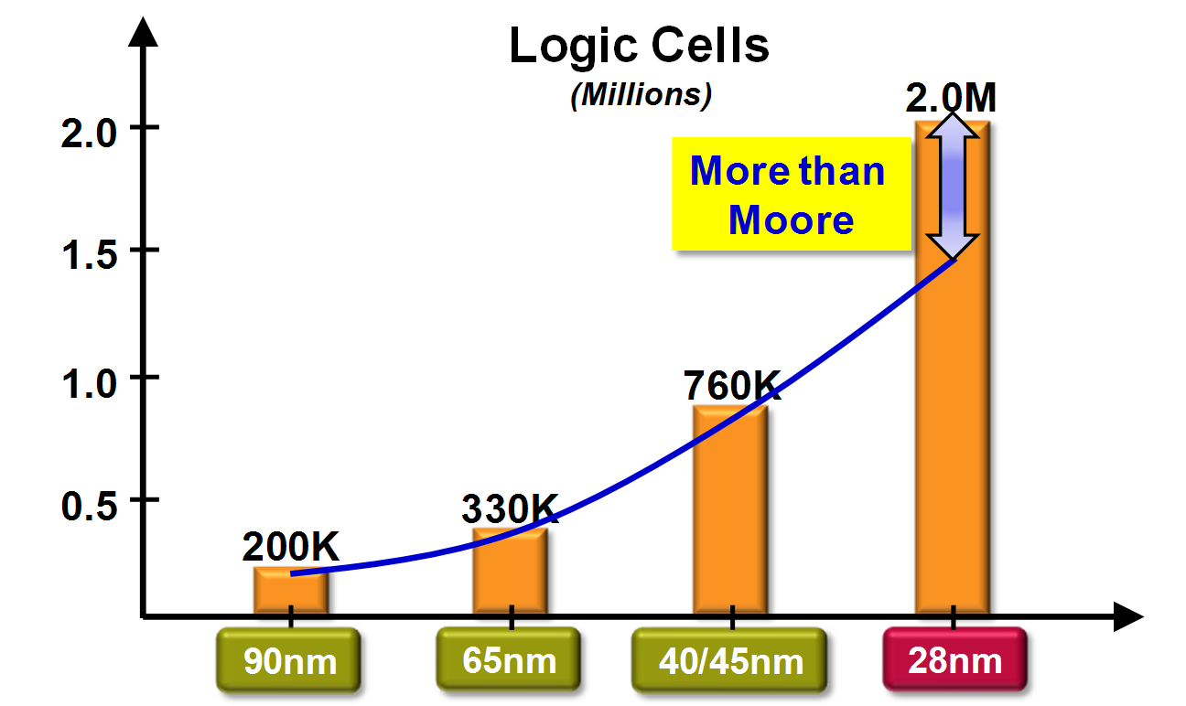
Stacked Silicon Interconnect Technology
Largest Virtex-7 device is almost three times the size of the largest Virtex-6 device
Growth is higher than Moore’s Law dictates
Enabled by Stacked Silicon Interconnect (SSI) technology
Multiple FPGA die on a silicon interposer
Each die is referred to as a Super Logic Region (SLR)
Vast quantity of interconnect between adjacent SLRs are provided by the interposer
65%
130%
163%
Notes:
SSI is used to create the largest Virtex-7, Virtex-7XT, and Virtex-7 HT devices.

Slide 22
Stacked Silicon Implications
Enables substantially larger devices
Device is treated as a single monolithic device
Tool chains place and route complete device as if it was one die
Minor design considerations around clocking and routing
28nm
FPGA Die
28nm
FPGA Die
28nm
FPGA Die
28nm
FPGA Die
Micro-bump
TSV
Si Interposer
C4 Bump
Package
Notes:
Design ramifications of using these large devices will be discussed later in this course.

Slide 23
Summary
Rich set of families to address all areas of the FPGA market
Artix-7 family: Lowest price and power
Kintex-7 family: Best price/performance
Virtex-7 family: Highest performance/capacity
Unified architecture reduces learning curve for new designs
Builds on the strengths of the Virtex-6 and Spartan-6 families
Strong focus on power reduction
New architectural features for the highest performance and lowest power

Slide 24
Where Can I Learn More?
Xilinx Education Services courses www.xilinx.com/training
Designing with 7-Series Device Families course
How to get the most out of both device families
How to build the best HDL code for your FPGA design
How to optimize your design for Spartan-6 and/or Virtex-6
How to take advantage of the newest device features
Free Video Based Training
Part 1,2, and 3 of the 7 Series FPGA Overview
How Do I Plan to Power My FPGA?
What are the Spartan-6 Power Management Features?
What are the Virtex-6 Power Management Features?
Basic FPGA Configuration, Parts 1 and 2

Slide 25
Trademark Information
Xilinx is disclosing this Document and Intellectual Property (hereinafter “the Design”) to you for use in the development of designs to operate on, or interface with Xilinx FPGAs. Except as stated herein, none of the Design may be copied, reproduced, distributed, republished, downloaded, displayed, posted, or transmitted in any form or by any means including, but not limited to, electronic, mechanical, photocopying, recording, or otherwise, without the prior written consent of Xilinx. Any unauthorized use of the Design may violate copyright laws, trademark laws, the laws of privacy and publicity, and communications regulations and statutes.
Xilinx does not assume any liability arising out of the application or use of the Design; nor does Xilinx convey any license under its patents, copyrights, or any rights of others. You are responsible for obtaining any rights you may require for your use or implementation of the Design. Xilinx reserves the right to make changes, at any time, to the Design as deemed desirable in the sole discretion of Xilinx. Xilinx assumes no obligation to correct any errors contained herein or to advise you of any correction if such be made. Xilinx will not assume any liability for the accuracy or correctness of any engineering or technical support or assistance provided to you in connection with the Design.
THE DESIGN IS PROVIDED “AS IS" WITH ALL FAULTS, AND THE ENTIRE RISK AS TO ITS FUNCTION AND IMPLEMENTATION IS WITH YOU. YOU ACKNOWLEDGE AND AGREE THAT YOU HAVE NOT RELIED ON ANY ORAL OR WRITTEN INFORMATION OR ADVICE, WHETHER GIVEN BY XILINX, OR ITS AGENTS OR EMPLOYEES. XILINX MAKES NO OTHER WARRANTIES, WHETHER EXPRESS, IMPLIED, OR STATUTORY, REGARDING THE DESIGN, INCLUDING ANY WARRANTIES OF MERCHANTABILITY, FITNESS FOR A PARTICULAR PURPOSE, TITLE, AND NONINFRINGEMENT OF THIRD-PARTY RIGHTS.
IN NO EVENT WILL XILINX BE LIABLE FOR ANY CONSEQUENTIAL, INDIRECT, EXEMPLARY, SPECIAL, OR INCIDENTAL DAMAGES, INCLUDING ANY LOST DATA AND LOST PROFITS, ARISING FROM OR RELATING TO YOUR USE OF THE DESIGN, EVEN IF YOU HAVE BEEN ADVISED OF THE POSSIBILITY OF SUCH DAMAGES. THE TOTAL CUMULATIVE LIABILITY OF XILINX IN CONNECTION WITH YOUR USE OF THE DESIGN, WHETHER IN CONTRACT OR TORT OR OTHERWISE, WILL IN NO EVENT EXCEED THE AMOUNT OF FEES PAID BY YOU TO XILINX HEREUNDER FOR USE OF THE DESIGN. YOU ACKNOWLEDGE THAT THE FEES, IF ANY, REFLECT THE ALLOCATION OF RISK SET FORTH IN THIS AGREEMENT AND THAT XILINX WOULD NOT MAKE AVAILABLE THE DESIGN TO YOU WITHOUT THESE LIMITATIONS OF LIABILITY.
The Design is not designed or intended for use in the development of on-line control equipment in hazardous environments requiring fail-safe controls, such as in the operation of nuclear facilities, aircraft navigation or communications systems, air traffic control, life support, or weapons systems (“High-Risk Applications”). Xilinx specifically disclaims any express or implied warranties of fitness for such High-Risk Applications. You represent that use of the Design in such High-Risk Applications is fully at your risk.
© 2012 Xilinx, Inc. All rights reserved. XILINX, the Xilinx logo, and other designated brands included herein are trademarks of Xilinx, Inc. All other trademarks are the property of their respective owners.

Slide 26
7 Series FPGA Overview
Part 3

Slide 27
Objectives
After completing this module, you will be able to:
Identify the dedicated IP in the 7 series FPGAs
Identify some of the differences between the 7 series and Virtex-6 FPGAs

Slide 28
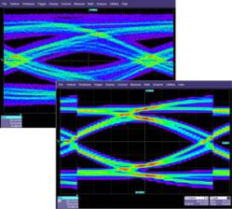
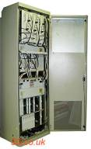
High-Speed Serial I/O Transceivers
Available in all families
GTP transceivers – up to 3.75 Gbps
Ultra high volume transceiver
Wire bond package capable
GTX transceivers – up to 12.5 Gbps
Support for the most common 10 Gbps protocols
GTH transceivers – up to 13.1 Gbps
Support for 10 Gbps protocols with high FEC overhead
GTZ transceivers – up to 28 Gbps
Enables next generation 100–400Gbps system line cards
Notes:
The number and type of HSSIO transceivers vary by family and device.

Slide 29
PCI Express
Features
Compliant to PCIe Revision 2.1
Endpoint & root port
AXI user interface
<100 ms configuration*
FPGA configuration over PCI Express*
End-to-end CRC*
Advanced error reporting*
100-MHz clocking
New wrappers
Multi-function*
Single-root I/O virtualization*
Configurations
Lane widths: x1-8
Data rates: Gen1 & Gen2 (2.5/5.0 Gbps)
Dependent on GT and fabric speed
GTX Transceivers
PCI Express Block
Transaction Layer
Data Link Layer
Physical Layer
Configuration module
*New features in 7 series

Slide 30
XADC: Dual 12-Bit 1-MSPS ADCs
17 External
Analog Inputs
XADC
ADC Results
Status Registers
ADC 1
Define XADC Operation
Initialize with Attributes
MUX
Control Registers
On-Chip Sensors
ADC 2
DRP
2 x 12 Bits
1 MSPS
JTAG
Arbitrator
On-Chip Sensors Supplies ±1%
Temperature ±4°C
Interconnect
Dynamic Reconfiguration Port
Notes:
The XADC is the evolution of the System Monitor in previous generations.
Each XADC contains two ADCs with significantly increased speed and precision.
Multiple XADC blocks exist in the larger FPGA devices.

Slide 31
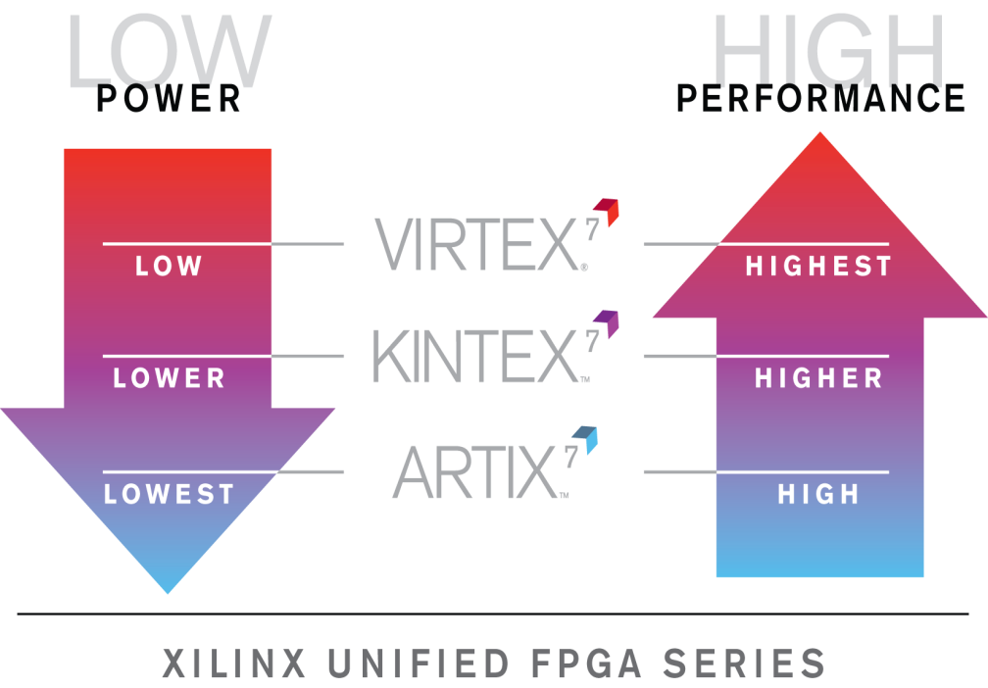
Cost, Power, and Performance
The different families in the 7 series provide solutions to address the different price/performance/power requirements of the FPGA market
Artix-7 family: Lowest price and power for high volume and consumer applications
Battery powered devices, automotive, commercial digital cameras
Kintex-7 family: Best price/performance
Wireless and wired communication, medical, broadcast
Virtex-7 family: Highest performance and capacity
High-end wired communication, test and measurement, advanced RADAR, high performance computing

Slide 32
I/O Composition
Each 7 series I/O bank contains one type of I/O
High Range (HR)
High Performance (HP)
Different devices have different mixtures of I/O banks
I/O Types | Artix-7 Family | Kintex-7 Family | Virtex-7 Family | Virtex-7 XT/HT Family
High Range | All | Most | Some
High Performance |  | Some | Most | All

Slide 33
Multi-Gigabit Transceiver
Different families have different MGT devices
Artix-7 family: GTP
Kintex-7/Virtex-7 family: GTX
Virtex-7 XT family: Mixture of GTX and GTH
Virtex-7 HT family: Mixture of GTH and GTZ
Speed Grade | Artix GTP |  | Kintex GTX |  |  | Virtex GTX |  | Virtex GTH |  | Virtex GTZ
 | min | max | min | max | max (FF) | min | max | min | max | min | max
1LC/I | 0.612 | 3.125 | 0.612 | 5.0 | 6.6 | 0.612 | 6.6 | 0.612 | 10.3125 | N/A | N/A
1C/I | 0.612 | 3.125 | 0.612 | 5.0 | 6.6 | 0.612 | 6.6 | 0.612 | 10.3125 | TBD | TBD
2C/I | 0.612 | 3.75 | 0.612 | 6.6 | 10.3125 | 0.612 | 10.3125 | 0.612 | 13.1 | 28.05 | 28.05
3C | N/A | N/A | 0.612 | 6.6 | 12.5 | 0.612 | 12.5 | 0.612 | 13.1 | 28.05 | 28.05

Slide 34
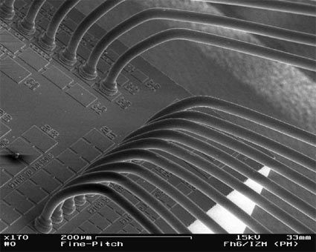
Packaging – Artix-7 Family
Ultra low-cost wire bond technology
Small form factor
Fourth generation sparse chevron pin pattern
Speeds up to 1.066 Gbps for parallel I/O
Speeds up to 3.75 Gbps for MGT
Notes:
Artix-7 devices will not be available in Quad Flat Pack (xQFP) packages.

Slide 35
Packaging – Kintex-7 Family
Kintex-7 devices are available in two different packages
Low cost bare die flip chip (FB) and conventional flip chip (FF)
Small form factor packaging available
Fourth generation sparse chevron pin pattern
Speeds up to 2.133 Gbps for parallel I/O
Speeds up to 12.5 Gbps for MGT in FF package, and 6.6 Gbps in FB package
FB package has discrete substrate decoupling capacitors for MGT power supplies
Exposed
Silicon Die
Exposed
Decoupling
Capacitors
Bare Die Flip Chip Package (FB)
Solder
Bumps
Package
Substrate
o o o o o
Solder Balls

Slide 36
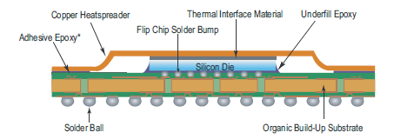
Packaging – Virtex-7 Family
High performance flip chip (FF) package
Fourth generation sparse chevron pin pattern
Speeds up to 2.133 Gbps for parallel I/O
Speeds up to 28.05 Gbps for MGT
Discrete substrate decoupling capacitors:
MGT power supplies
Block RAM power supplies
I/O pre-driver power supplies

Slide 37
Summary
Rich set of families to address all areas of the FPGA market
Artix-7 family: Lowest price and power
Kintex-7 family: Best price/performance
Virtex-7 family: Highest performance/capacity
Unified architecture reduces learning curve for new designs
Builds on the strengths of the Virtex-6 and Spartan-6 families
Strong focus on power reduction
New architectural features for the highest performance and lowest power

Slide 38
Where Can I Learn More?
Xilinx Education Services courses www.xilinx.com/training
Designing with 7-Series Device Families course
How to get the most out of both device families
How to build the best HDL code for your FPGA design
How to optimize your design for Spartan-6 and/or Virtex-6
How to take advantage of the newest device features
Free Video Based Training
Part 1,2, and 3 of the 7 Series FPGA Overview
How Do I Plan to Power My FPGA?
What are the Spartan-6 Power Management Features?
What are the Virtex-6 Power Management Features?
Basic FPGA Configuration, Parts 1 and 2

Slide 39
Trademark Information
Xilinx is disclosing this Document and Intellectual Property (hereinafter “the Design”) to you for use in the development of designs to operate on, or interface with Xilinx FPGAs. Except as stated herein, none of the Design may be copied, reproduced, distributed, republished, downloaded, displayed, posted, or transmitted in any form or by any means including, but not limited to, electronic, mechanical, photocopying, recording, or otherwise, without the prior written consent of Xilinx. Any unauthorized use of the Design may violate copyright laws, trademark laws, the laws of privacy and publicity, and communications regulations and statutes.
Xilinx does not assume any liability arising out of the application or use of the Design; nor does Xilinx convey any license under its patents, copyrights, or any rights of others. You are responsible for obtaining any rights you may require for your use or implementation of the Design. Xilinx reserves the right to make changes, at any time, to the Design as deemed desirable in the sole discretion of Xilinx. Xilinx assumes no obligation to correct any errors contained herein or to advise you of any correction if such be made. Xilinx will not assume any liability for the accuracy or correctness of any engineering or technical support or assistance provided to you in connection with the Design.
THE DESIGN IS PROVIDED “AS IS" WITH ALL FAULTS, AND THE ENTIRE RISK AS TO ITS FUNCTION AND IMPLEMENTATION IS WITH YOU. YOU ACKNOWLEDGE AND AGREE THAT YOU HAVE NOT RELIED ON ANY ORAL OR WRITTEN INFORMATION OR ADVICE, WHETHER GIVEN BY XILINX, OR ITS AGENTS OR EMPLOYEES. XILINX MAKES NO OTHER WARRANTIES, WHETHER EXPRESS, IMPLIED, OR STATUTORY, REGARDING THE DESIGN, INCLUDING ANY WARRANTIES OF MERCHANTABILITY, FITNESS FOR A PARTICULAR PURPOSE, TITLE, AND NONINFRINGEMENT OF THIRD-PARTY RIGHTS.
IN NO EVENT WILL XILINX BE LIABLE FOR ANY CONSEQUENTIAL, INDIRECT, EXEMPLARY, SPECIAL, OR INCIDENTAL DAMAGES, INCLUDING ANY LOST DATA AND LOST PROFITS, ARISING FROM OR RELATING TO YOUR USE OF THE DESIGN, EVEN IF YOU HAVE BEEN ADVISED OF THE POSSIBILITY OF SUCH DAMAGES. THE TOTAL CUMULATIVE LIABILITY OF XILINX IN CONNECTION WITH YOUR USE OF THE DESIGN, WHETHER IN CONTRACT OR TORT OR OTHERWISE, WILL IN NO EVENT EXCEED THE AMOUNT OF FEES PAID BY YOU TO XILINX HEREUNDER FOR USE OF THE DESIGN. YOU ACKNOWLEDGE THAT THE FEES, IF ANY, REFLECT THE ALLOCATION OF RISK SET FORTH IN THIS AGREEMENT AND THAT XILINX WOULD NOT MAKE AVAILABLE THE DESIGN TO YOU WITHOUT THESE LIMITATIONS OF LIABILITY.
The Design is not designed or intended for use in the development of on-line control equipment in hazardous environments requiring fail-safe controls, such as in the operation of nuclear facilities, aircraft navigation or communications systems, air traffic control, life support, or weapons systems (“High-Risk Applications”). Xilinx specifically disclaims any express or implied warranties of fitness for such High-Risk Applications. You represent that use of the Design in such High-Risk Applications is fully at your risk.
© 2012 Xilinx, Inc. All rights reserved. XILINX, the Xilinx logo, and other designated brands included herein are trademarks of Xilinx, Inc. All other trademarks are the property of their respective owners.

